Slide 1
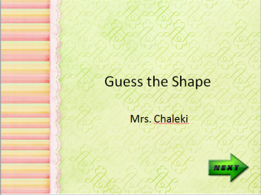
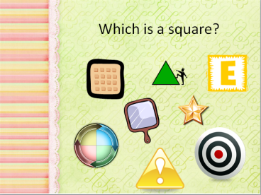
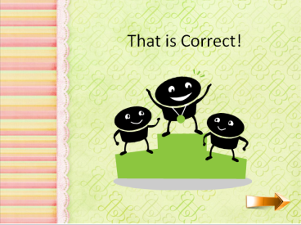
Slide 1
Slide 1 hyperlinks to Slide 2
All squares hyperlink to Slide 3
Other shapes hyperlink to Slide 4
Slide 2
Slide 3
Slide 3 hyperlinks to Slide 5
Slide 4
Slide 4 hyperlinks to Slide 2
Slide 5
All Circles hyperlink to Slide 6
Other shapes hyperlink to Slide 7
Slide 6
Slide 6 hyperlinks to Slide 1
Slide 7
Slide 7 hyperlinks to Slide 5

